Slide 1
LUMI
A BABY MONITOR PROJECT BUILD

Slide 2
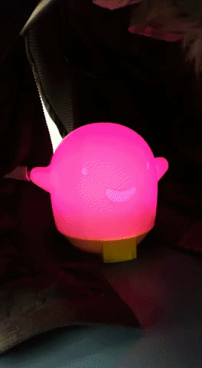
INTRODUCTION
BABY MONITOR
IN COLLABORATION WITH INTERACTIVE MEDIA PROGRAM
PLANS TO WORK WITH ANDROID APP

Slide 3
THE PROPOSAL
TO UTILIZE THE SENSORS IN CONCERT
LISTENS TO THE BABY’S CRYING
REACTS TO LOW LIGHT LEVELS

Slide 4
BUDGET
NEOPIXEL $10.99
SOUND SENSOR $3.02
LIGHT SENSOR $8.99
RASPBERRY PI 3 KIT $99.99
PROXIMITY SENSOR $7.81
SUBTOTAL $122.99
TOTAL $138.98

Slide 5
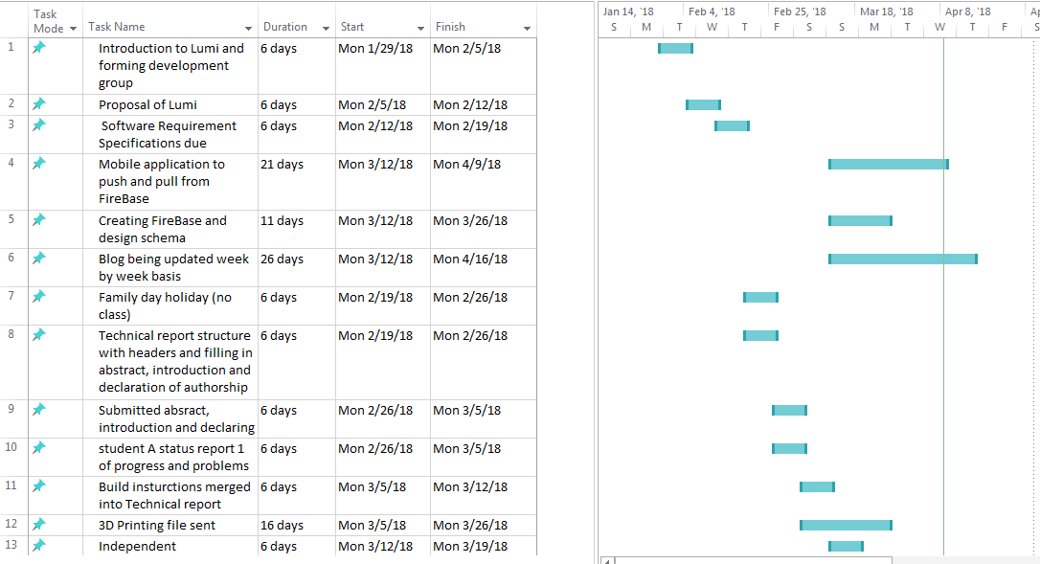

Slide 6
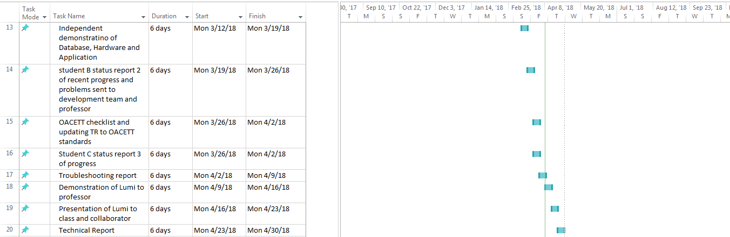

Slide 7
PREVIOUS COURSE KNOWLEDGE
TECH 101 ELECTRIC CIRCUITS
TECH 150 ELECTRONIC DEVICES AND CIRCUITS
TECH 104 PROGRAMMING FUNDAMENTALS
CENG 212 PROGRAMMING TECHNIQUES IN JAVA
TECH 153 TECHNICAL C
CENG 319 SOFTWARE PROJECT

Slide 8
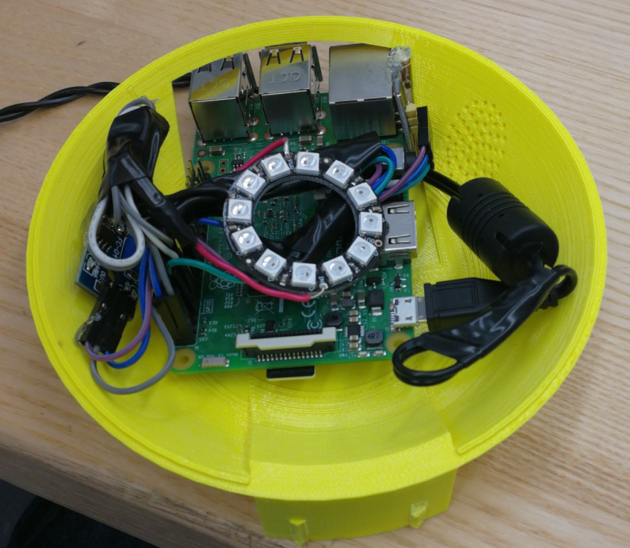

Slide 9
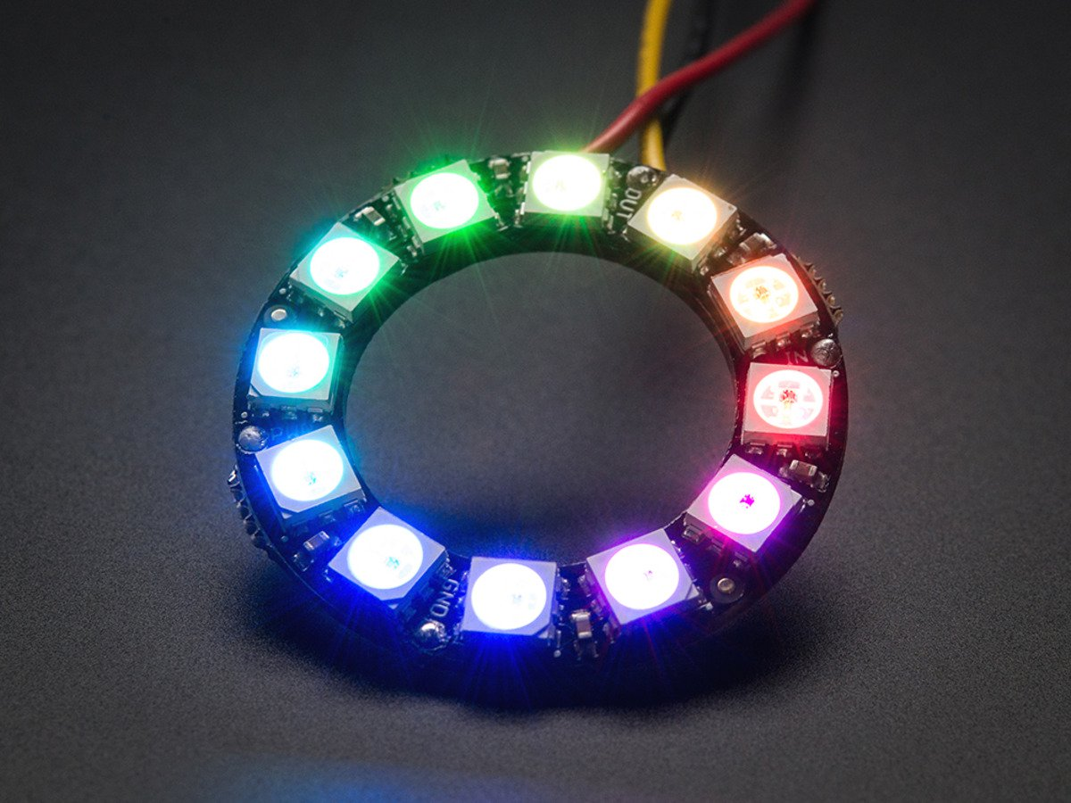
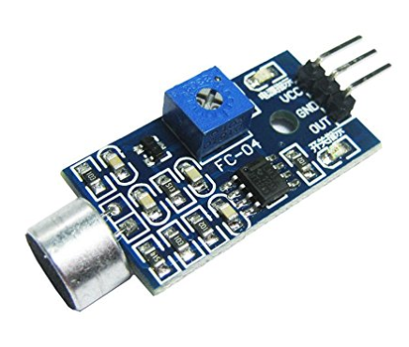
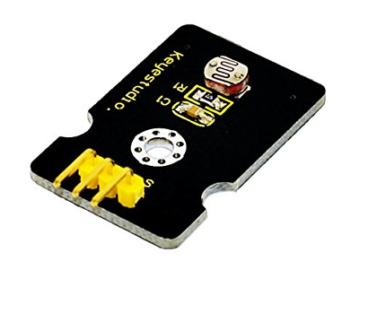
SENSORS & REACTORS
NEOPIXEL RING
SOUND DETECTOR
LIGHT DETECTOR

Slide 10
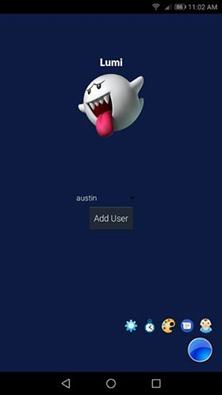
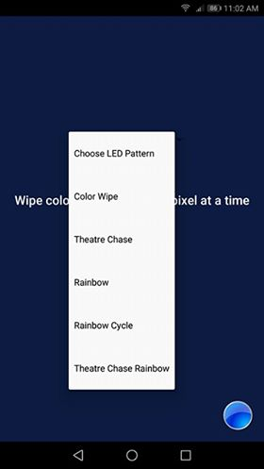
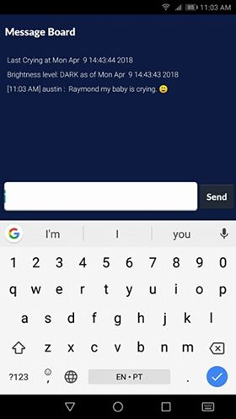

Slide 11

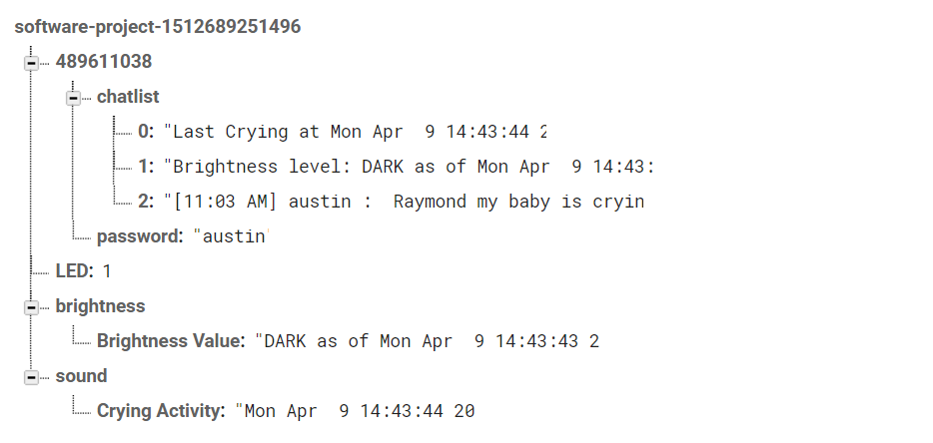

Slide 12
CONCLUSION
PROJECT SUCCESS
PROBLEMS WITH COMMERCIALIZATION
READY TO SCALE

Slide 13
THANK YOU

